Slide 1


Cloud Kitchen Opportunity Analysis
Using Swiggy market data,
analysis to identify high demand cuisines and profitable areas for a new cloud kitchen
Presented By
Olasunkanmi-Ojo Mariam

Slide 2

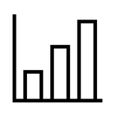





Executive summary: the opportunity
7,865
3.7
53.6 min
599
368
Total restaurant analyzed
Average ratings
Average delivery time
Unique cuisines
Average price
My research process
Analyzed Swiggy platform data across different cities and areas
Identified market gaps and opportunities
Found the optimal cuisine, location, and pricing strategy

Slide 3





Dataset & Methodology
Analysis tools
Power BI for visualization and analysis
Statistical correlation analysis
Geographic and competitive mapping
DAX measures for dynamic insights.
Data Sources
Swiggy restaurant dataset (kaggle)
Scope: 7865 restaurant across different cities
Document Assumptions
We note any projections or estimates so stakeholders understand the data context and methodology behind the visuals.
Cleaning, feature engineering & validation
Removed duplicates, fixed formatting issues, and filtered out errors to ensure data is reliable.

Slide 4

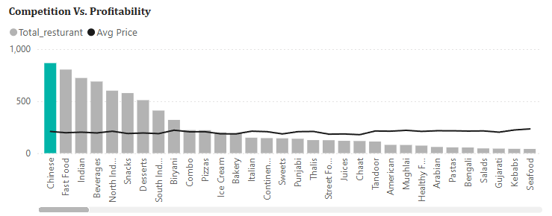


Key Findings 1: Market saturation
Oversaturation market
Premium Opportunity
  Chinese, North Indian, South Indians restaurant at 200 - 300 avg price are overaturated with 2100+ resturants.
  High competition = Lower margins
  Continental, Asian and Italian cuisines in Korean, Japanese and Indonesian have fewer competitors.
  Average price: 1150
  Same/better ratings: 4.3 - 4.6 average
Recommendation: Focus on premium Asian, Italian cuisines for 40-60% margin improvement

Slide 5
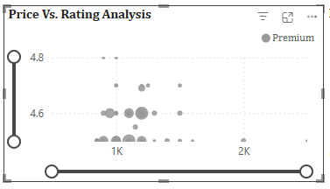
Key Findings 2: Price Rating sweet spot
Price Tier Analysis
Strategic Positioning
  Budget (<₹300): 3.8-4.0 rating average
  Medium (₹300-800): 4.0-4.3 rating average
  Premium (>₹800): 4.2-4.5 rating average
  ₹500-700 range balances quality & accessibility
  Premium perception without exclusivity
  Maintains healthy profit margins
Recommendation: Target ₹500-700 pricing for optimal customer satisfaction and profitability to achieve 4.2+ ratings.

Slide 6

Key Findings 3: Geographic Opportunities
Top opportunity areas
Girish Park
⭐ 4.9
🏪 1 restaurant(s)💰 ₹300 avg
Strategy: Premium entry, first-mover advantage
Vardhman Premium Mall
⭐ 4.8
🏪 1 restaurant(s)💰 ₹700 avg
Strategy: Premium delivery hub
Esplanade
⭐ 4.5
🏪 5 restaurant(s) 💰 ₹307 avg
Strategy: Quality differentiation
Avoid: High density areas (20+ restaurants) with average ratings (4.0-4.2)

Slide 7
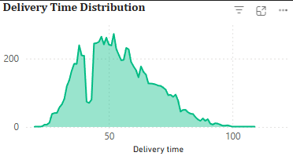
Key Findings 4: Delivery time opportunity
Current market state
Competitive advantage
  Average delivery: 53.6 minutes
  Peak concentration: 50-60 minutes
  Fast delivery (<40 min): Only 15% of restaurants
  25% faster than market average
  Reduces food quality degradation
  Improves ratings by 0.3-0.5 points
Recommendation: Target 35-40 mins delivery for 25% speed advantage

Slide 8
Business Plan
premium cloud kitchen
The strategy
✓ Location analytics: Optimal area identification
✓ Cuisine recommendations: Demand-gap analysis
✓ Pricing strategy: Competitive benchmarking
✓ Performance tracking: Real-time market monitoring
Revenue model
Daily orders
40 orders
Conservative estimate
Average Order Value
₹600
Premium positioning
Monthly revenue
₹7.2 Lakhs
₹86.4L annually

Slide 9

Recommendations;
why this will succeed
  🎯 Focus on Premium Asian Fusion (Korean, Japanese, Indonesian)
  ⚡ Optimize for <40 minute delivery through strategic location
  💰 Price between ₹500-700 for optimal rating-profitability balance
Cloud kitchen model = lower investment, and higher flexibility

Slide 10
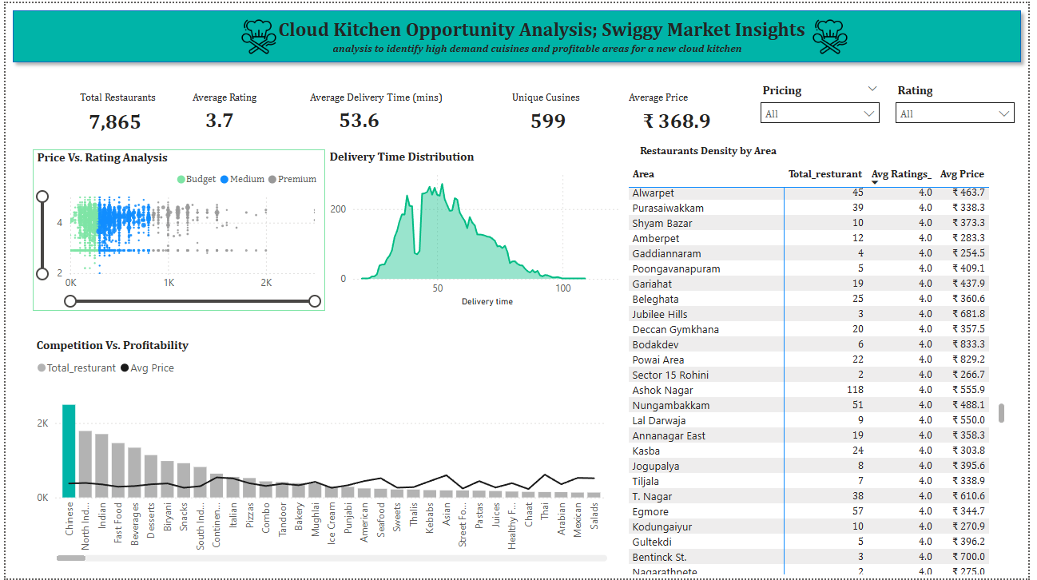
Thank you!

